Slide 1


Chapter 11-12
苏佳林
Notes:
Word emdedding的应用
Case study

Slide 2

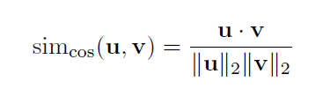

Using word embeddings
1
OBTAINING WORD VECTORS:
  train from a corpus: Word2Vec, GenSim
  download pre-trained word vectors: Google, Stanford
WORD SIMILARITY:
  cosine similarity
WORD CLUSTERING
  The word vectors can be easily clustered using clustering algorithms such as KMeans that are defined over Euclidean spaces. The clusters can then be used as features in learning algorithms that work with discrete features, or in other systems that require discrete symbols such as IR indexing systems.

Slide 3


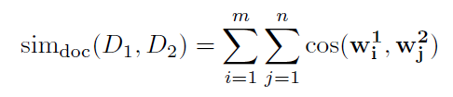
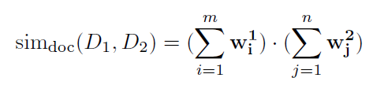
Using word embeddings
2
FINDING SIMILAR WORDS:
  with row-normalized embeddings matrix
  often interested in the k most similar words to a given word
SIMILARITY TO A GROUP OF WORDS:
ODD-ONE OUT:
  This can be done by computing the similarity between each word to the average word vector of the group, and returning the least similar word.
SHORT DOCUMENT SIMILARITY:
  The idea is to represent each document as a bag-of-words, and define the similarity between the documents to be the sum of the pairwise similarities between the words in the documents

Slide 4



Using word embeddings
3
WORD ANALOGIES:
  For example, for word embeddings trained using Word2Vec, one could take the vector of the word king, subtract the word man, add the word woman and get that the closest vector to the result (when excluding the words king, man and woman) belongs to the word queen.

Slide 5
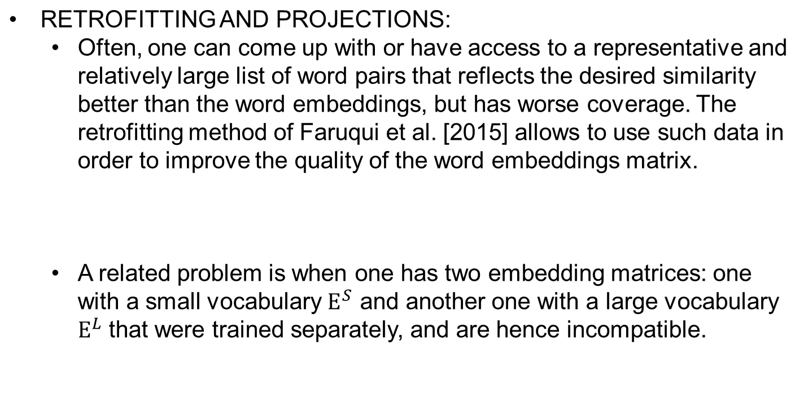
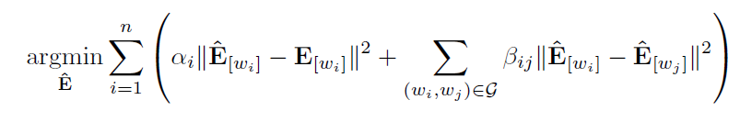
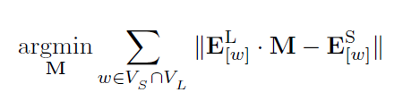
Using word embeddings
4

Slide 6
Case Study
5
A Feed Forward Architecture for Sentence Meaning Inference
We will follow the network presented by Parikh et al. [2016] for the Stanford Natural Language Inference (SNLI) semantic inference task.

Slide 7
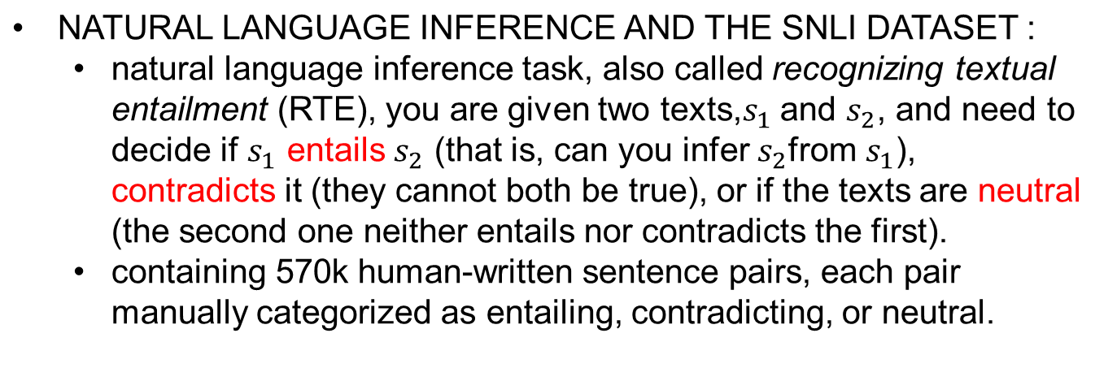
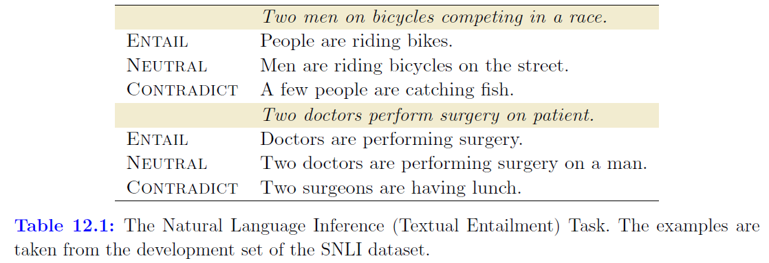
Case Study
6

Slide 8
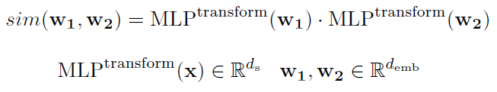

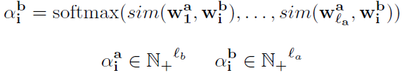
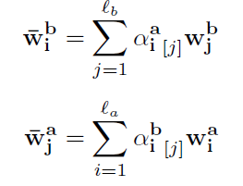
Case Study
7
A TEXTUAL SIMILARITY NETWORK:
  similarity function for two word vectors is defined to be:
  alignment vector:
  weighted-sum:

Slide 9
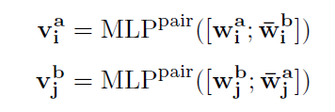
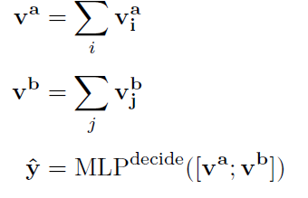
Case Study
8
A TEXTUAL SIMILARITY NETWORK:
  representation vector that focuses on the important information for the task by using feed-forward network:
  sum the resulting vectors and pass them into a final MLP classifier for predicting the relation between the two sentences (entail, contradict or neutral ):

Slide 10
9
Case Study
A TEXTUAL SIMILARITY NETWORK:
  The transform network learns a similarity function for word-level alignment. After the transform network, each word vector is similar to other words that are likely to refer to the same entity or the same event.
  The goal of this network is to find words that may contribute to the entailment. We get alignments in both directions: from each word in a to multiple words in b, and from each word in b to multiple words in a. The alignments are soft, and are manifested by weighted group membership instead of by hard decisions, so a word can participate in many pairs of similarities.

Slide 11
Case Study
10
A TEXTUAL SIMILARITY NETWORK:
  The pair network then looks at each aligned pair (word + group) using a weighted-CBOW representation, and extracts information relevant to the pair.
  Finally, the decide network looks at the aggregated data from the word pairs, and comes up with a decision based on all the evidence.

Slide 12
Thanks

